Slide 1
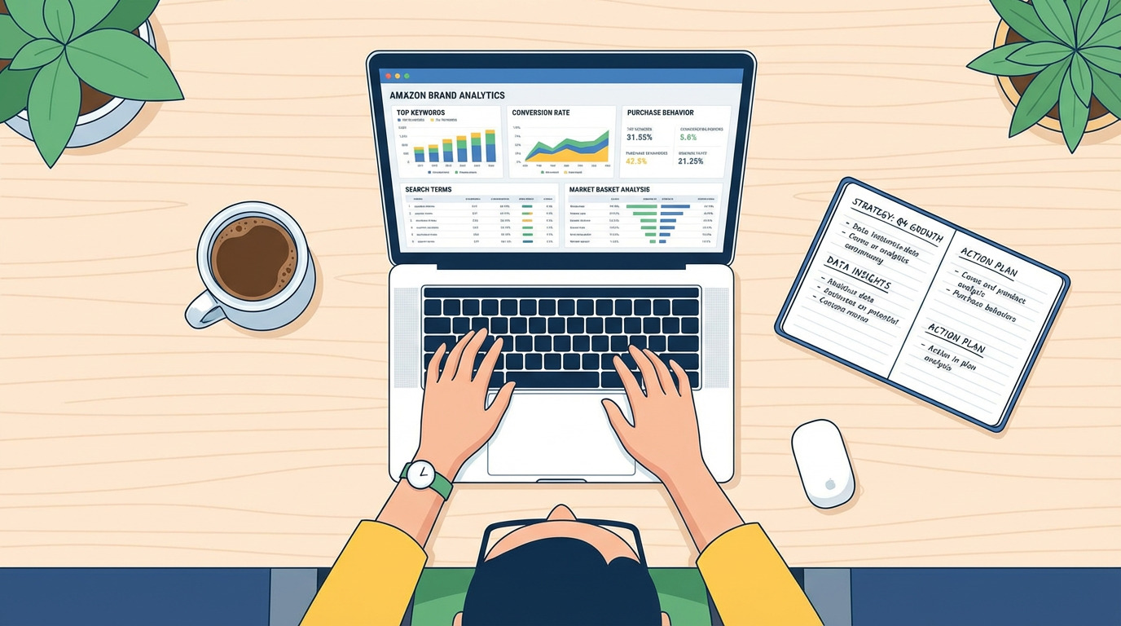

Slide 2
Smart Sales & Customer Analysis Dashboard Using Python & Tableau
Making sense of AI data tools
Presented By: BHOOMIKA R

Slide 3
Introduction
This project presents an AI-powered Sales and Customer Analytics System that transforms raw business data into actionable insights. The system uses Python for data preprocessing and machine learning tasks such as sales forecasting, customer segmentation, and product recommendation. The processed data is visualized through Tableau dashboards for interactive business intelligence

Slide 4
Literature Review
Year | Authors | Title / Research Focus | ML Technique | Key Findings | Relation to this Project
2021 | Chen el | Sales Forecasting using Regression Models | Linear Regression | Regression models effectively predict short-term sales trends | I integrate regression forecasting with Tableau dashboards
2023 | Kumar & Singh | Customer Segmentation in Retail Analytics | K-Means Clustering | Clustering improves targeted marketing and customer retention | I combine segmentation with forecasting
2024 | Wang & Zhao | Machine Learning in Business Intelligence Systems | ML + BI Integration | ML enhances decision-making in BI systems | Our project integrates AI models with Tableau

Slide 5

Objectives
Calculate KPIs (Sales, Profit, Orders)
Forecast future sales using ML
Segment customers automatically
Recommend best-selling products
Create interactive Tableau dashboards
Analyze sales performance

Slide 6

Problem Definition & Formulation
Organizations cannot:
Predict sales
Identify top customers
Recommend products
Visualize insights effectively
Solution
Develop a system that:
Data → AI Models → Dashboard → Insights
This Photo by Unknown Author is licensed under CC BY

Slide 7
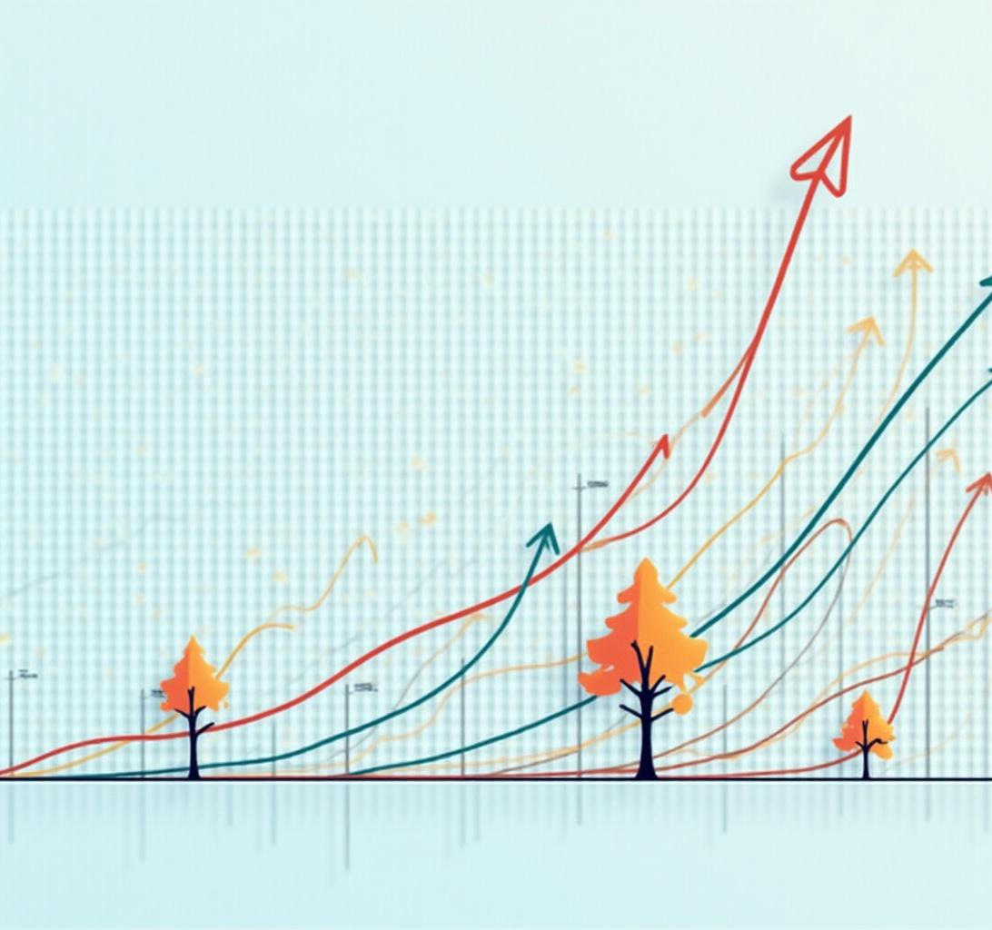
Machine Learning Models for Prediction
Algorithms:
Sales Forecasting
Linear Regression [Predicts next month sales]
Customer Segmentation
K-Means Clustering [Groups customers]
Recommendation
Top-product analysis [Suggests best-selling product]

Slide 8
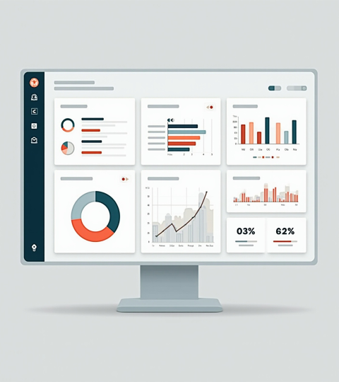
Dashboards using Tableau

Slide 9
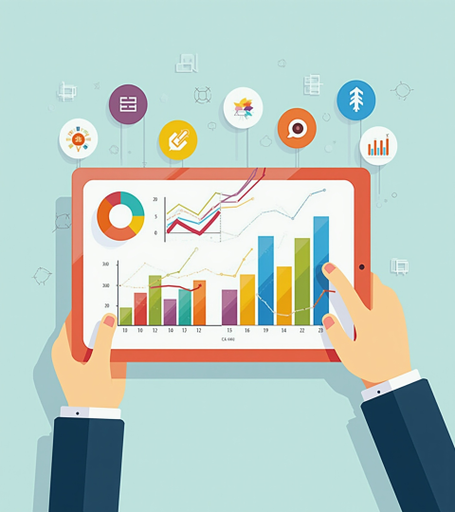
Data Visualization with Tableau
Tableau makes your data look good and easy to understand. It creates interactive dashboards that help you spot trends and track sales metrics in a flash. Being able to see the data visually makes decision-making faster and more intuitive for everyone.

Slide 10
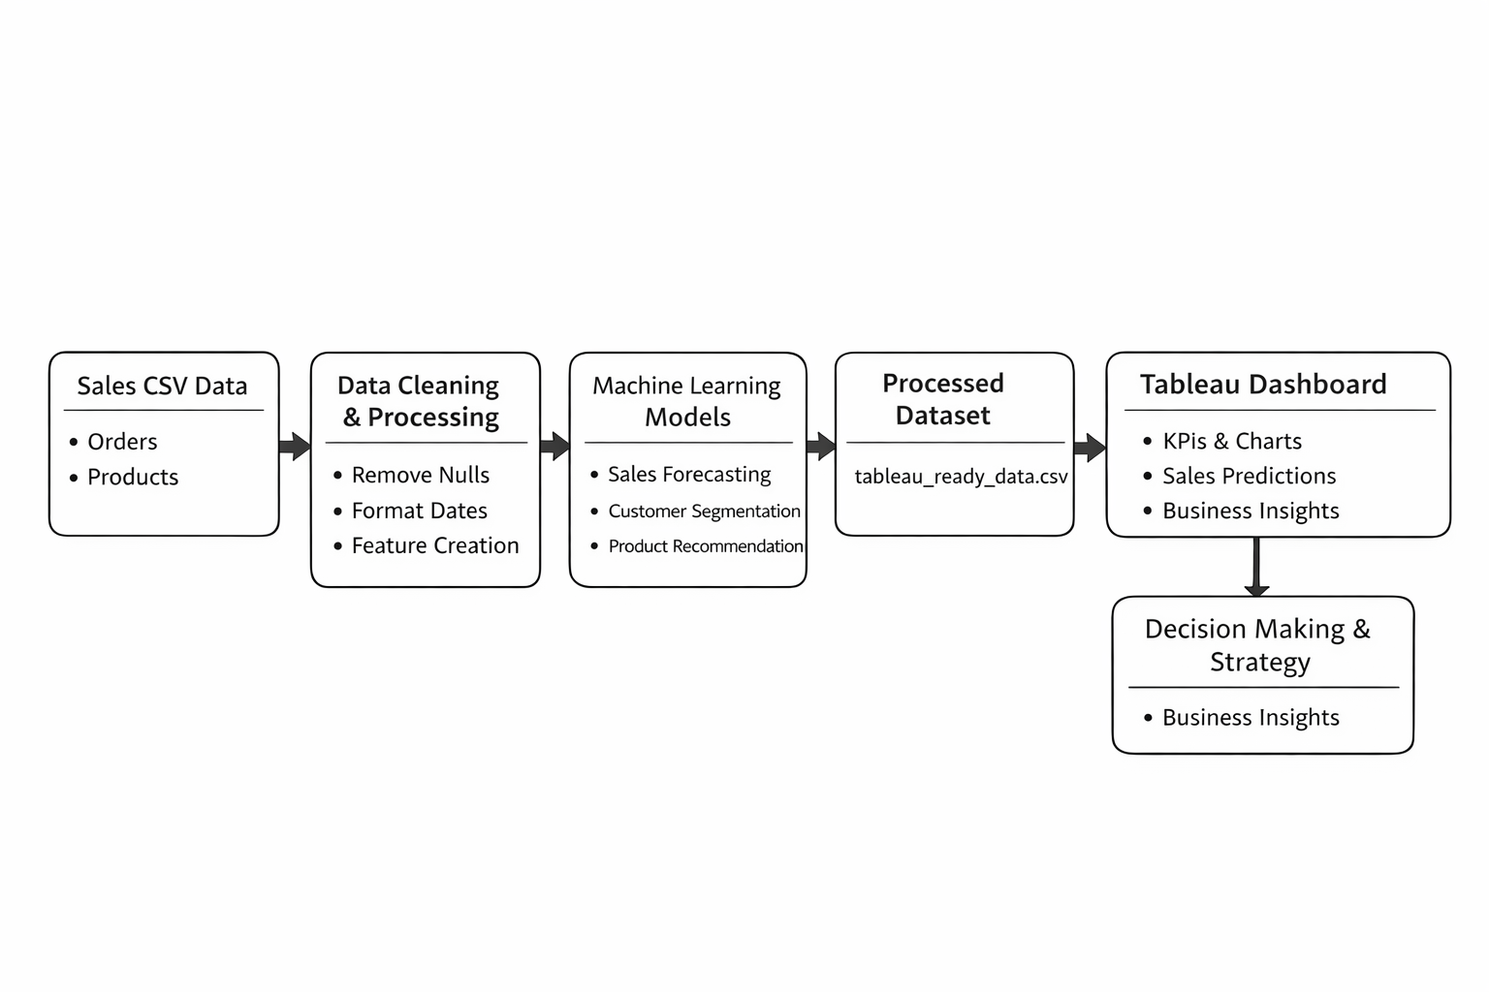
Flowchart

Slide 11

Conclusions
Using AI and smart dashboards together makes sales forecasting a lot easier and more accurate. Python handles the heavy lifting behind the scenes, while Tableau helps your team see and understand data clearly. Together, these tools help businesses stay ahead and make smarter, faster decisions.

Slide 12
Thank You..!

